Slide 1
CONSTITUTION OF SWITZERLAND
FEATURES

Slide 2
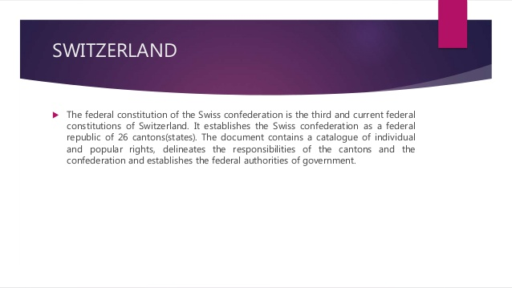

Slide 3
The basis for the present day Federal Constitution is the Constitution of 12 September 1848, which established the Swiss federal state. This document was heavily influenced by the US Constitution and the ideals of the French Revolution.
In 1866, the Constitution of 1848 underwent a partial revision. The first total revision came into force in 1874. It introduced wider powers for the federal government and gave more democratic rights to the electorate. This total revision also introduced the referendum at federal level.
In the 1990s, the Federal Constitution was revised and updated. This total revision was approved by the People and the cantons on 18 April 1999 by majorities of 59.2% and 14 out of 26 cantons respectively. It replaced the previous Federal Constitution of 29 May 1874 .It came into force on 1 January 2000.

Slide 4
Written, Enacted and Adopted Constitution
The Swiss Constitution is a written and enacted constitution. It was drafted by a committee of the Swiss Parliament in 1848 and was approved by the Parliament, the Cantons and the people of Switzerland. In a similar way it was totally revised in 1874. This Constitution operated during 1874-1999.
It has 196 articles and these have been classified into six titles and each of which contains several chapters.

Slide 5
A rigid Constitution
The Swiss constitution is a rigid constitution. The constitution cannot be amended by ordinary law making process. The process of amending the constitution is complicated.
An amendment can become law only when it is approved by majority of the Swiss voters and by a majority of the cantons.

Slide 6
A Republican Constitution
The Constitution of Switzerland is Republican in character. It is also believed that Switzerland is the first to experiment with the Republican institution in the world.
The constitution establishes Republicanism not only at the centre but also in various cantons. Being a Republic, all potential institutions of Switzerland - Federal, Cantonal and Communal are elective in character.
The principal of Republicanism is in fact the bullwark of Swiss democracy.

Slide 7
Federalism
Art 1 of the 1874 Swiss constitution describe Switzerland as a Confederation.
But in reality, It was a Federation with 23 cantons (20 full & 6 half cantons) constituting the federation.
The 1999 total revision of the constitution has further given strength to the federation.
Switzerland is now a federation both in name as well as on reality.

Slide 8
Continue…
The Federal character of the Swiss Constitution is reflected by its following features; Non-Sovereign status of Cantons, Supremacy of Swiss Constitution, Existence of Written and rigid constitution affecting a division of powers between the Swiss Federation and the cantons, the cantons have their separate constitution etc. All these features clearly established the existence of a federation in Switzerland.

Slide 9
Direct Democracy
Switzerland has been the home of direct democracy. Since 1848, Switzerland has been working as a direct democracy through such devices of direct legislation- Referendum and initiative.
Under the system of referendum, the people have the right to approve or disapprove the laws or constitutional amendment passed by their legislature.
Under the systems of initiative Swiss voters can initiate any proposal for Constitutional amendment, which get incorporated in the constitution when majority of Swiss voters as well as of cantons approves it in referendum.

Slide 10
Plural Executive
A unique features of the Swiss constitution is that it provides for plural executive which consists of seven members elected by the Federal Assembly for four years.
The executive powers are collectively exercised by the Federal Council. The president is elected by the Federal Assembly for a period of one year only, and is simply "first among equals". He in no way enjoys a position superior to that of the rest of his colleagues.

Slide 11
Bicameral Legislature
The Federal Assembly is the legislative power of Switzerland. Its two chambers – the National Council and the Council of States –have the same powers but meet separately.
The National Council, or “lower chamber”, represents the people and comprises 200 members who are elected by popular vote for a four-year term. The number of representatives sent by each canton depends on the size of its population.
The Council of States, or “upper chamber”, represents the cantons and comprises 46 members, who are also elected directly by the people for a four-year term. Regardless of their population size, the cantons send two deputies,

Slide 12
Bill of Rights
A major change affect by the new Swiss Constitution has been the incorporation of a detailed bill of Rights. Under Title 2 chapter 1 and 2 and article 7 to 40, the new constitution describes the basic, civil, social and political rights of the Swiss people.
The bill of rights is a very detailed bill and incorporates almost all the rights and freedoms which stand recognized as essential conditions of civilized living and necessary for the enjoyment of the right to life.

Slide 13
Dual Citizenship
The system of double citizenship prevails in Switzerland. The constitution states that every citizen of the cantons shall be the citizen of Switzerland. This entitles a person to enjoy the citizenship of his cantons as well as that of the Swiss Federation.

Slide 14
No Judicial Review
The Swiss judiciary play a less vital role then the judiciary in India or USA. The Swiss Federal Tribunal has only limited judicial review authority. It can declare only cantonal law unconstitutional. But it does not exercise judicial review of the laws passed by the central government.

Slide 15
Permanently Neutralized Status
Switzerland is a permanently neutralized state. This status has been conferred upon Switzerland by an international treaty. Switzerland has taken upon itself the decision that it shall join neither any war nor military alliance. It refuses to be drawn into any military/controversial security related conference/ treaty/ organisation and alliance. Till 2002 it was not even a member of the United Nations. It joined the world body only in 2003 but without giving up its permanently neutralized status.

Slide 16


